Slide 1
School system

Slide 2
OUTLINE
Project map
Files
Functions

Slide 3
project
School.h
School.c
Main.c

Slide 4
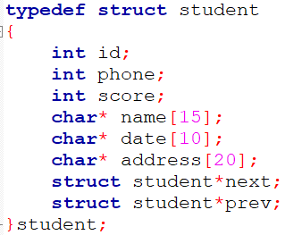
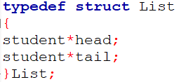
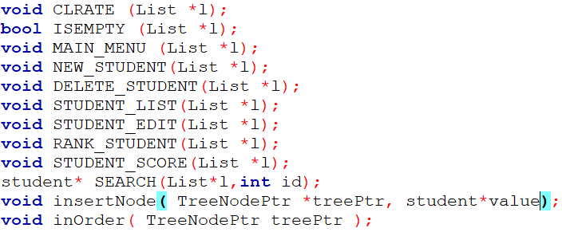
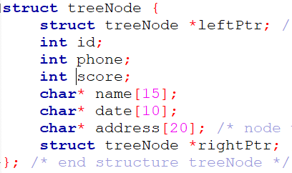
School .h
In this file we make declaration for all functions and variable data type.
We make three struct student ,list and treenode.

Slide 5


school.c
In this file we make definition for all functions and header files.
1-CREATE function
this function take list pointer.
Return void.
Assume head and tail NULL.
2-ISEMPTY function
This function take list pointer.
Return bool.
Check head of the list is equal NULL or no.
Check the list is empty or no

Slide 6
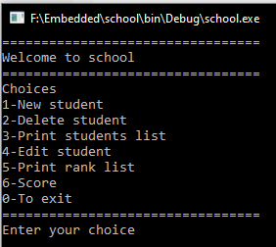
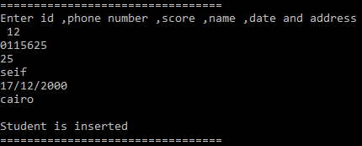
school.c
3-MAIN_MENU function
this function take list pointer.
Return void.
Print welcome massage and menu of options.
In this functions we use do while loop and switch control statements.
4-NEW_STUDENT function
this function take list pointer. Return void.
Ask user to enter student’s information.
Take this information then put it in doubly linked list.
When it finish print the “student is inserted”.

Slide 7
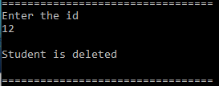
school.c
5-DELETE function
this function take list pointer. Return void.
Ask user to enter the id to make search by SEARCH function.
If the id is found the student will delete if not print “ID not found”.
6-STUDENT_LIST function
This function take list pointer.
Return void.
Print the student list sorted by name.

Slide 8
school.c
7-STUDENT_EDIT function
this function take list pointer. Return void.
Ask user to enter the id ,address ,phone and birthday date.
It edit address ,score ,phone and birthday date only .
8- RANK_STUDENT function
This function take list pointer. Return void.
Print students list sorted by score.

Slide 9
school.c
9-STUDENT_SCORE function
this function take list pointer.
Return void.
Edit score for all students.
10- SEARCH function
This function take list pointer and integer id.
Return student pointer.

Slide 10
school.c
11-insertNode function
this function take treenode pointer and student pointer.
Return void.
Insert doubly list in tree sorted by score.
12- inOrder function
This function take treenode pointer .
Return void.
Print students list sorted by score .

Slide 11
main.c
In this file we include school.h.
Declare object from list.
We use CREATE function to create the list.
Use MAIN_MENU .

Slide 12
Thank you

